Slide 1
M- WAY TREES
ADITYA TIWARI
ASSISTANT PROFESSOR
CSVTU, BHILAI

Slide 2
A multi-way tree is a tree that can have more than two children
A multi-way tree of order m (number or a **m-way tree) is one in which a tree can have m children.
An m-way search tree is a m-way tree in which:
a) Each node has m children and m-1 key fields
b) The keys in each node are in ascending order.
c) The keys in the first i children are smaller than the i^{th} key
d) The keys in the last m-i children are larger than the i^{th} key

Slide 3
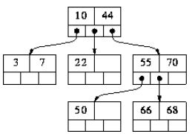

Slide 4
In a binary search tree, m=2. So it has one value and two sub trees.
The figure above is a m-way search tree of order 3.
M-way search trees give the same advantages to m-way trees that binary search trees gave to binary trees - they provide fast information retrieval and update.
However, they also have the same problems that binary search trees had - they can become unbalanced, which means that the construction of the tree becomes of vital importance.

Slide 5
In m-way search tree, each sub-tree is also a m-way search tree and follows the same rules.
An extension of a multi-way search tree of order m is a B-tree of order m.
This type of tree will be used when the data to be accessed / stored is located on secondary storage devices because they allow for large amounts of data to be stored in a node.

Slide 6
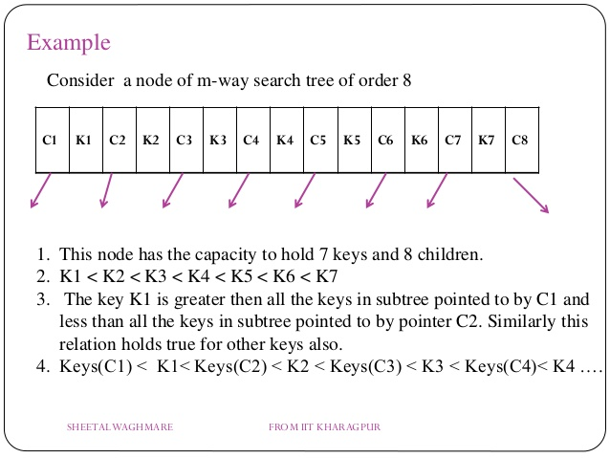

Slide 7
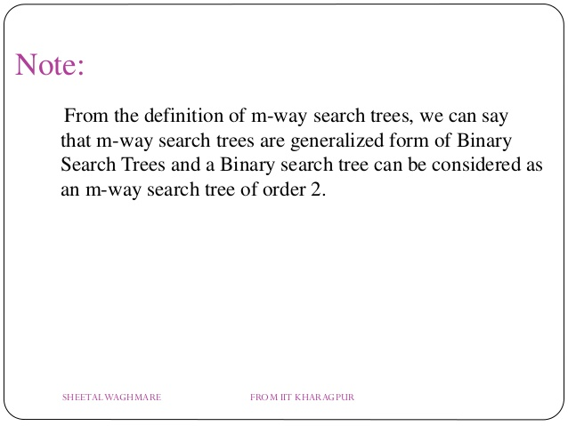

Slide 8
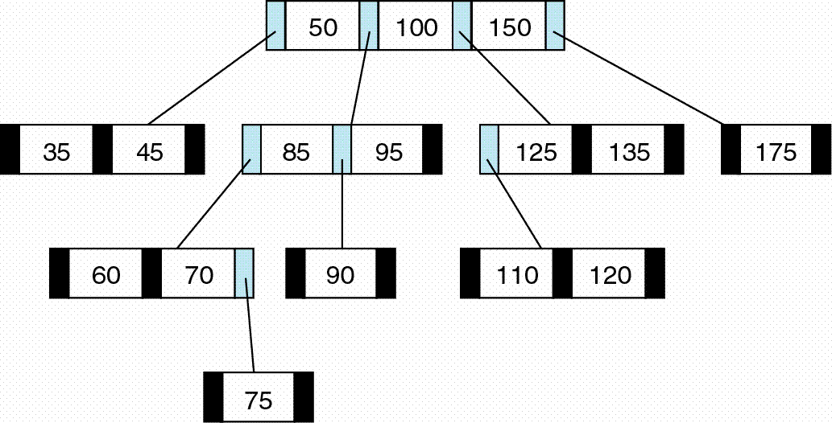

Slide 9
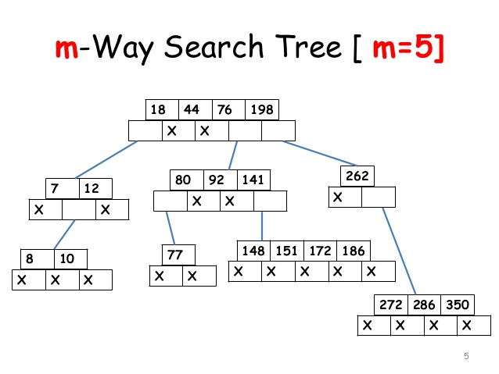

Slide 10
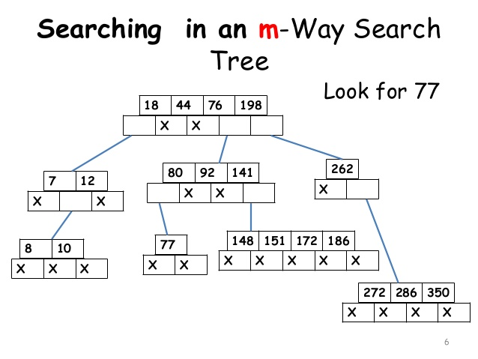

Slide 11
Thank You

